Slide 1
Library Management System
1
(SRS)
Submitted by: ABBAS AHMAD
Roll No. : FA17-BSE-024
)

Slide 2
Library Management System
2
INTRODUCTION
With the increase in the number of readers, better management of libraries system is required. The Library management system focuses on improving the management of libraries in a city or town. “What If you can check whether a book is available in the library through your phone?” or “what if instead of having different library cards for different libraries you can just have one ?” or “you can reserve a book or issue a book from your phone sitting at your home!”. The Integrated Library Management system provides you the ease of issuing, renewing, or reserving a book from an library within your town through your phone. The Integrated Library Management system is developed on the android platform which basically focuses on issuing, renewing and reserving a book.
PURPOSE
The purpose of the project is to maintain the details of books and library members of different libraries. The main purpose of this project is to maintain a easy circulation system between clients and the libraries, to issue books using single library card, also to search and reserve any book from different available libraries and to maintain details about the user (fine, address, phone number).Moreover, the user can check all these features from their home.
SCOPE
Manually updating the library system into an android based application so that the user can know the details of the books available and maximum limit on borrowing from their computer and also through their phones.
The ILM System provides information's like details of the books, insertion of new books, deletion of lost books, limitation on issuing books, fine on keeping a book more than one month from the issued date.
Also user can provide feedback for adding some new books to the library.
Definition, Acronyms, Abbreviation:
JAVA -> platform independence
SQL -> Structured query Language
DFD -> Data Flow Diagram
CFD -> Context Flow Diagram
ER -> Entity Relationship
IDE -> Integrated Development Environment
SRS -> Software Requirement Specification

Slide 3
3
OVERALL DESCRIPTION
PRODUCT PRESPECTIVE
The proposed Library Management System will take care of the current book detail at any point of time. The book issue, book return will update the current book details automatically so that user will get the update current book details.
SOFTWARE REQUIREMENT
Front end:
Android developer tool
Advance java
Back end:
MySQL
HARDWARE REQUIREMENT
Android version 2.3 ginger bread(minimum, android user’s)
2GB ram
1.2 GHz processor
Intel i5
Windows 7/8/8.1/10
2.4.1 FUNCTIONAL REQUIREMENT
R.1:Register
Description : First the user will have to register/sign up. There are two different type of users.
The library manager/head : The manager have to provide details about the name of library
,address, phone number, email id.
Regular person/student : The user have to provide details about his/her name of address, phone number, email id.
R.1.1: Sign up
Input: Detail about the user as mentioned in the description.
Output: Confirmation of registration status and a membership number and password will be generated and mailed to the user.
Processing: All details will be checked and if any error are found then an error message is displayed else a membership number and password will be generated.
R.1.2 : Login
Input: Enter the membership number and password provided.
Output : User will be able to use the features of software.
R.2 : Manage books by user.
R.2.1 : Books issued.
Description : List of books will be displaced along with data of return.

Slide 4
4
R.2.2 : Search
Input : Enter the name of author's name of the books to be issued.
Output : List of books related to the keyword.
R.2.3 : Issues book
State : Searched the book user wants to issues.
Input : click the book user wants.
Output : conformation for book issue and apology for failure in issue.
Processing : if selected book is available then book will be issued else error will be displayed.
R.2.4 : Renew book
State : Book is issued and is about to reach the date of return.
Input : Select the book to be renewed.
Output : conformation message.
Processing : If the issued book is already reserved by another user then error message will be send and if not then conformation message will be displayed.
R.2.5 : Return
Input ; Return the book to the library.
Output : The issued list will be updated and the returned book will be listed out.
R.2.6 ; Reserve book
Input ; Enter the details of the book.
Output : Book successfully reserved.
Description : If a book is issued by someone then the user can reserve it ,so that later the user can issue it.
R.2.6 Fine
Input : check for the fines.
Output : Details about fines on different books issued by the user.
Processing : The fine will be calculated, if it crossed the date of return and the user did not renewed if then fine will be applied by Rs 10 per day.
R.3 Manage book by librarian
R.3.1 Update details of books
R.3.1.1 Add books
Input : Enter the details of the books such as names ,author ,edition, quantity.
Output : confirmation of addition.
R.3.1.2 Remove books
Input : Enter the name of the book and quantity of books.
Output : Update the list of the books available.

Slide 5
5
Non Functional Requirements
Usability Requirement
The system shall allow the users to access the system from the phone using android application. The system uses a android application as an interface. Since all users are familiar with the general usage of mobile app, no special training is required. The system is user friendly which makes the system easy.
Availability Requirement
The system is available 100% for the user and is used 24 hrs a day and 365 days a year. The system shall be operational 24 hours a day and 7 days a week.
Efficiency Requirement
Mean Time to Repair (MTTR) - Even if the system fails, the system will be recovered back up within an hour or less.
Accuracy
The system should accurately provide real time information taking into consideration various concurrency issues. The system shall provide 100% access reliability.
Performance Requirement
The information is refreshed depending upon whether some updates have occurred or not in the application. The system shall respond to the member in not less than two seconds from the time of the request submittal. The system shall be allowed to take more time when doing large processing jobs. Responses to view information shall take no longer than 5 seconds to appear on the screen.
Reliability Requirement
The system has to be 100% reliable due to the importance of data and the damages that can be caused by incorrect or incomplete data. The system will run 7 days a week, 24 hours a day.
USER CHARACTERSTICS
We have 3 levels of users :
User module: In the user module, user will check the availability of the books.
▪
▪
▪
▪
Issue book Reserve book Return book Fine details
Library module:
Add new book
Remove books
Update details of book
Administration module:
The following are the sub module in the administration module :
Register user
Entry book details
Book issue

Slide 6
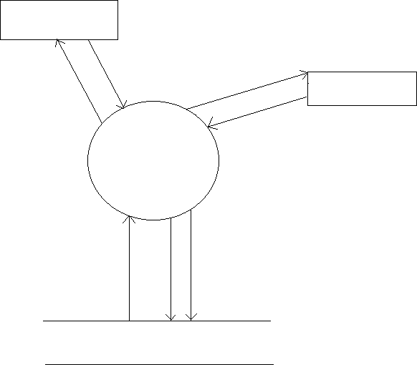
6
2.6 CONSTRAINTS
Any update regarding the book from the library is to be recorded to have update & correct values, and any fine on a member should be notified as soon as possible and should be correctly calculated.
2.7 FLOW DIAGRAM
Library
Update details of books
Register/login
Register/login
Member
Issue, search, return, reserve books
Library Management System
LIBRARY DATABASE

Slide 7
7
2.8 USE CASE MODEL DESCRIPTION:
Use Case selection | Description
Use Case name | Add student and library record
Level | Sub-Functional level
Primary actor | Student, Library
Stakeholders and interest | Student: wants to register into the system. Library: wants to register into the system and update book details. Administrator: responsible for the management of the transaction of fine and also login and register details.
Pre-condition | Students and Library have submitted their registration form.
Post-condition | Record for a student/library has been added.
Main success scenario | Student/Library opens the application to access the services of the LMS Student/Library sign-up to get registered online. He/She provides correct information and secret password. He/She got registered.
Alternative flow | Student/Library opens the application in their phone He/She tries to sign-up He/She fails and receives an error He/She will report an error and the error will be rectified as soon as possible.
Specific requirement | The response time for registration is 1 minute. The response time for login is 1 minute
Table 1: table for use case description.

Slide 8
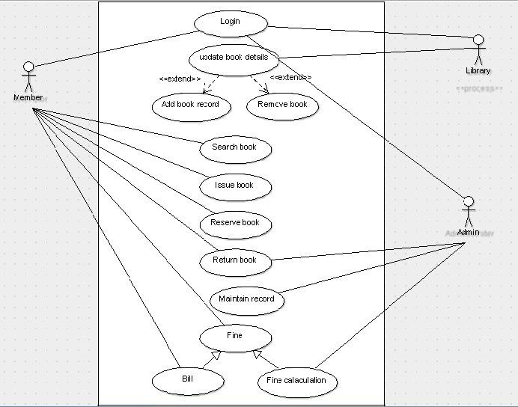
8
2.9.1 USE CASE DIAGRAM
<<include>>
<<include>>

Slide 9
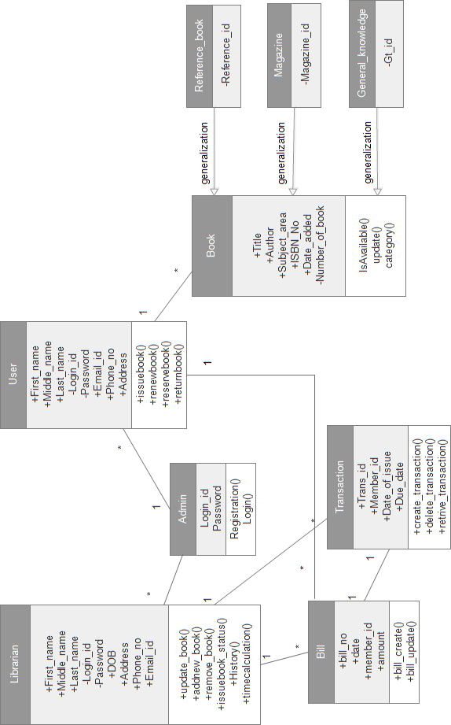
9
2.9.2 CLASS DIAGRAM
Fig 2. Class diagram

Slide 10
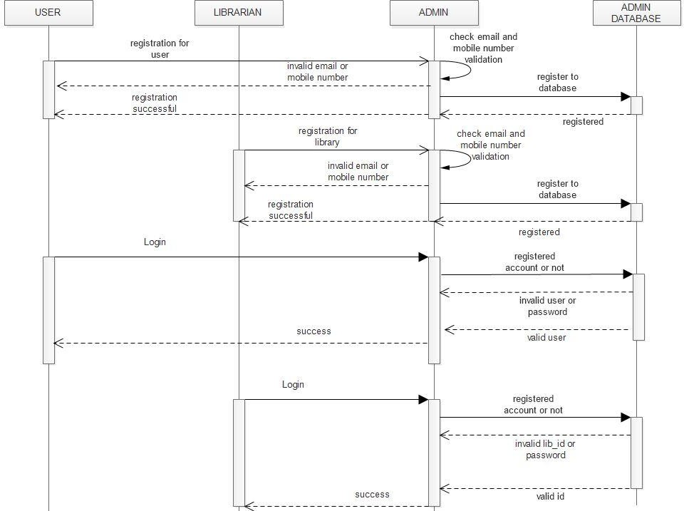
10
2.9.3 Sequential diagram
Fig 4(a). Register and login sequence diagram

Slide 11
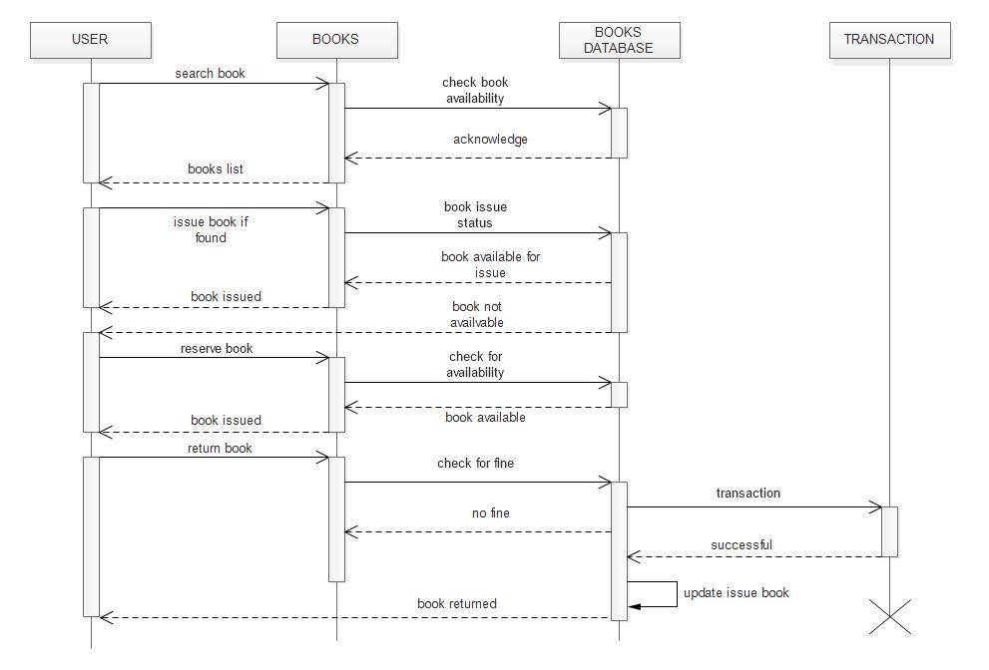
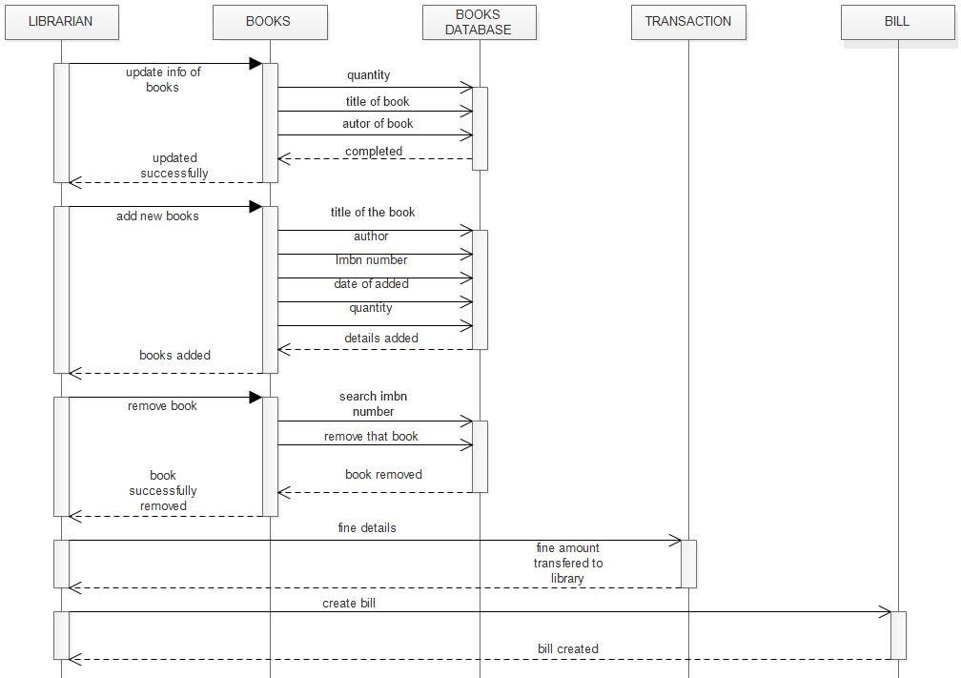
11
Fig 4(b) Services user could use
Fig 4(c) Services of a library

Slide 12
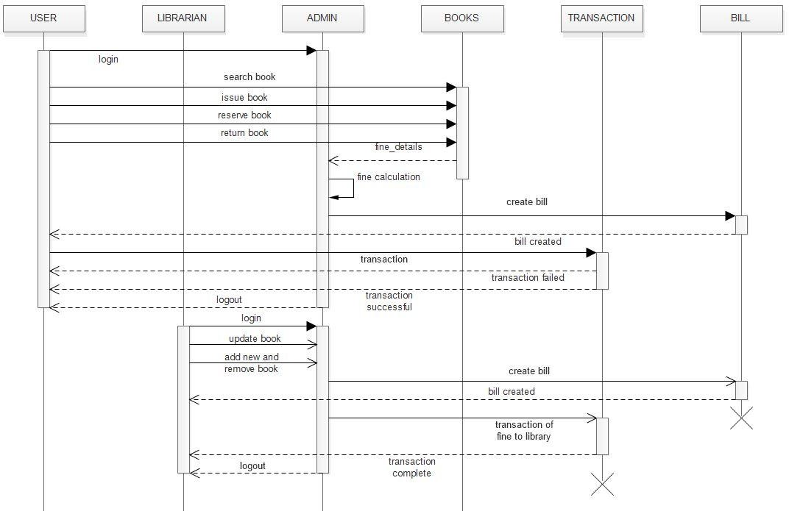
12
Fig 4(d) Full working of the system

Slide 13
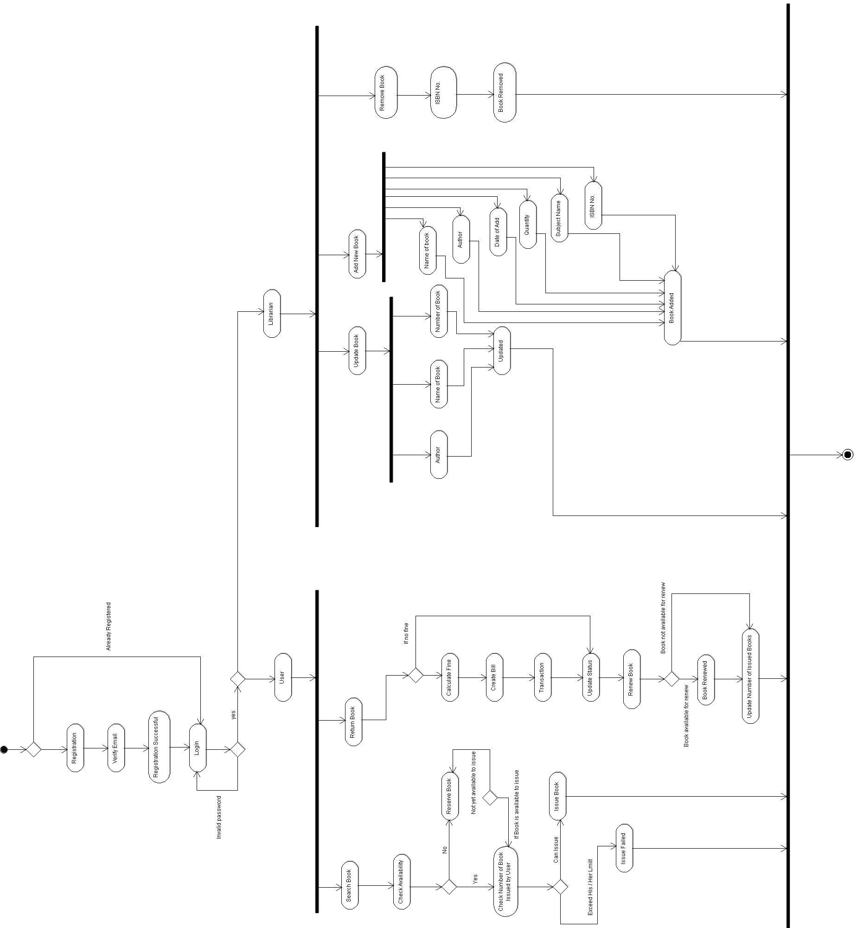
13
2.9.4 ACTIVTY DIAGRAM

Slide 14
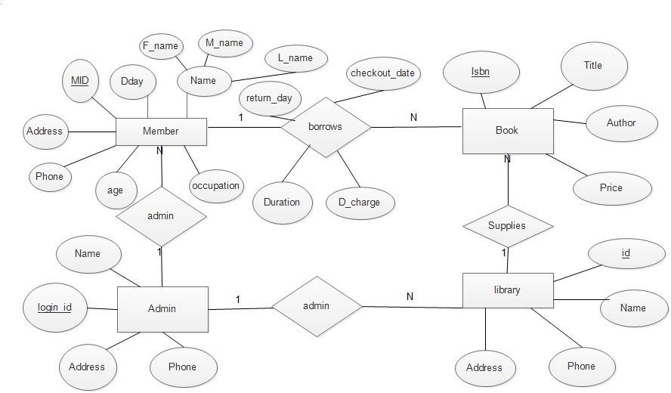
14
2.10 ER diagram
Assumptions and Dependencies
The product needs following third party applications for the development of the project:
Android Studio (for development of android based applications)
Netbeans
Photoshop (for editing layouts, icons, buttons, etc)

